Slide 1
Capstone Project-1
Hotel Bookings Analysis

Slide 2
Introduction We have a Data set for Resort Hotel and City hotel which has information includes per night stay, Agents, types of booking, Repeated guest, Country where it is located, Group of Members staying, Meal provided to guest, Distribution channel, ADR, Customer types, Cancelation, Numbers of days in waiting list, Reservation status, Required car parking Spaces, Assigned room Type, Previous cancelation and many others. On behalf of these information we are suppose to analyze following points. What is the best time of year to book the hotel room? What is the optimal length of stay to get the best ADR(Average Daily Rate)? What if you wanted to predict whether or not a hotel was likely to receive a disproportionately high number of special requests?

Slide 3
Analysis based on:- Distribution of Booking(Total, Confirmed, Canceled) Number of special requests Arival period Minimum night spent Number of Special request ADR

Slide 4
Data Cleaning
The columns children, country, agent, company have null values. We Removed Null values.
For the missing values in the country column, replace it with mode (value that appears most often)
Removed duplicate values.
For missing children value, replaced it with rounded mean value
The percentage of null values in column company has very high. As we donot have enough data to analyze on company, we can neglect the column company.
As the column agent represent the ID of each agent staring from 1 to 535, we cannot replace this null values with mean or median as these are categorical. So we replaced the null values with new ID
The percentage of null values in column company has very high. As we do not have enough data to analyze on company, we can neglect the column company.

Slide 5
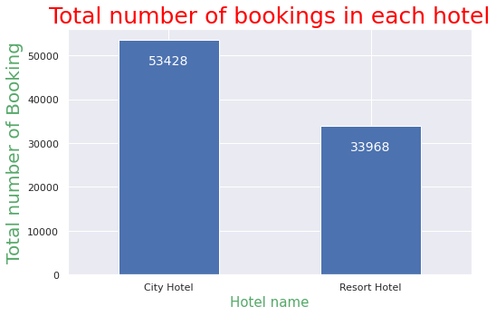
Best time of Year to book a Hotel room
Total number of booking in each Hotel.
We have data available for two hotels
which is City Hotel and Resort Hotel and to do our analysis we have to compare both
We plotted a graph to compare the number of bookings in two hotel
Here we can see that Total number of Booking is higher in City Hotel then resort Hotel
Con

Slide 6
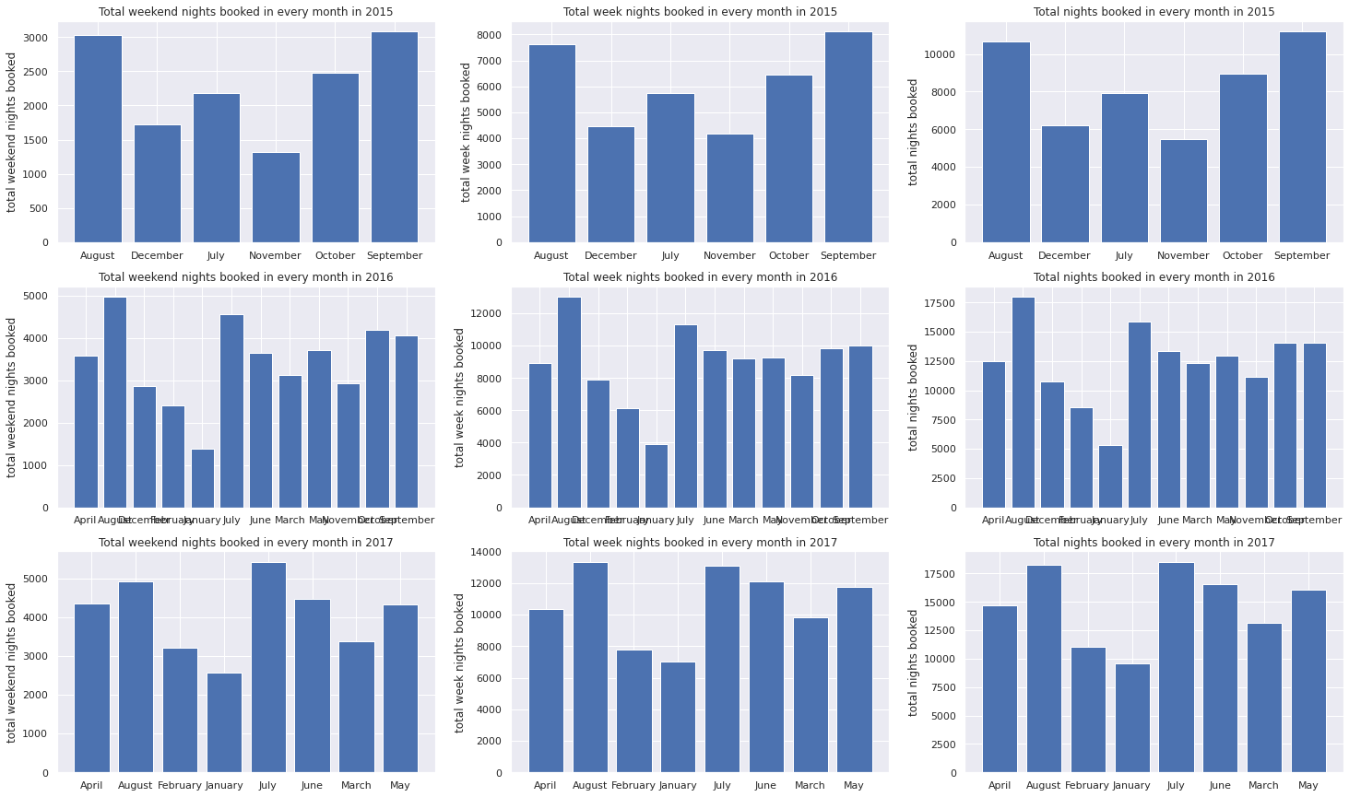
Nights booked in every month in 2017
Con

Slide 7
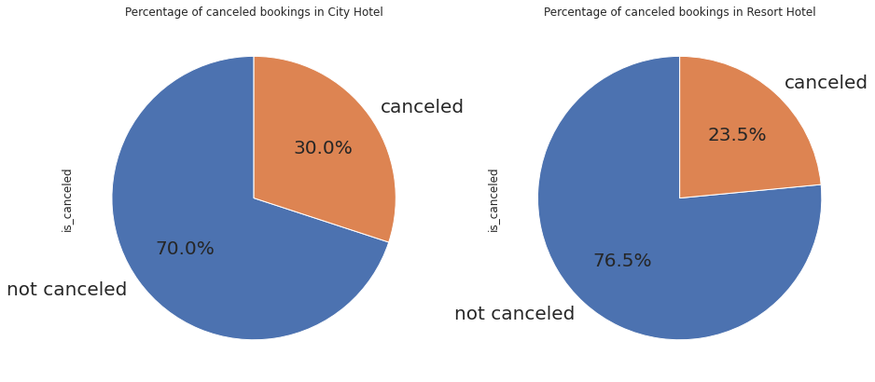
Calculating Booking Cancelation Percentage for City Hotel and Resort Hotel
Con

Slide 8
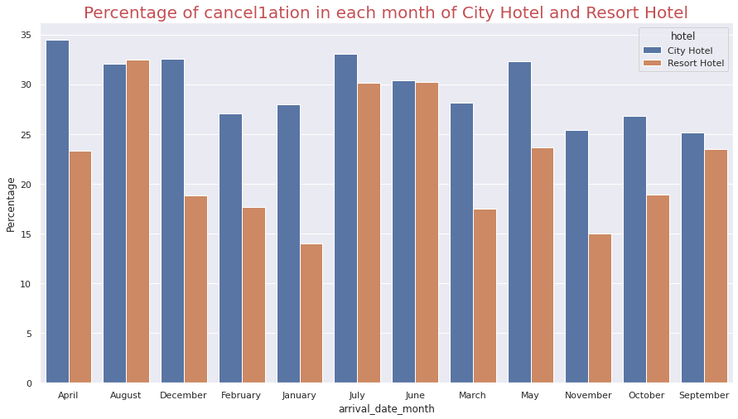
Comparison between cancelation percentage for both Hotel Every month
In this graph we can compare the cancelation percentage of City Hotel and Resort Hotel.
In the month of January the cancel percentage is very less for Resort Hotel group.
In the month of November the cancel percentage is very less for City Hotel
January is the best time for booking Resort Hotel Group and November is the best time to book City Hotel.

Slide 9
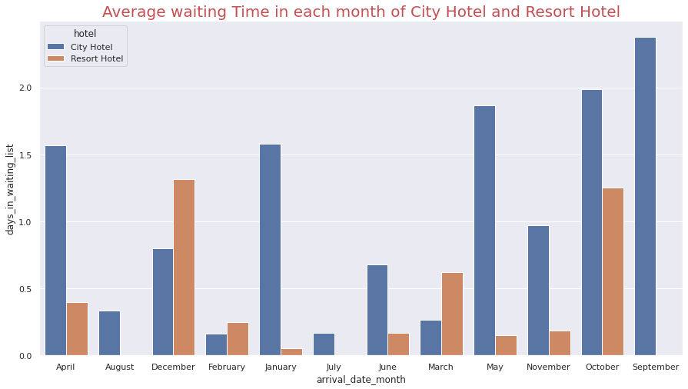
Average waiting time in Each Month for City Hotel and Resort Hotel
In this graph we compare Average waiting time between both hotel in respective month.
The average waiting time in the month of January is very less for Resort Hotel and the average waiting time in the month of February is very less for City Hotel
So the month January is the best month of year to book a Resort hotel room and the month February is the best time to book City hotel as there is less waiting list

Slide 10
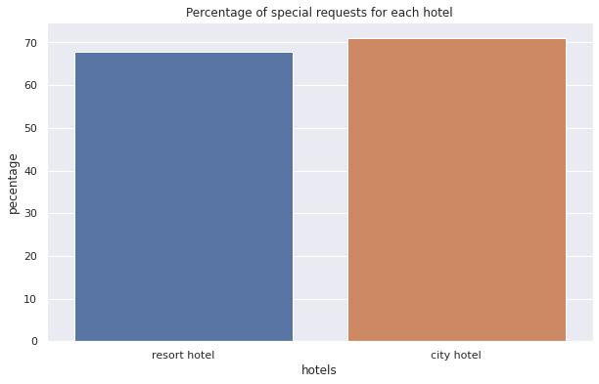
Number of Special request received by City Hotel and Resort Hotel
In this graph we compare Number of special request received by both Hotels
Probability of receiving special request is high for both the hotels
But the City hotel likely to receive a high number of special requests as its percentage of special requests is 71

Slide 11
Optimal length of stay in order to get the best daily rate To calculate optimal length of stay we have to consider several factors Average daily rate for different market segments Price Per month of a Hotel Price per day for single adults Price per day for two adults

Slide 12
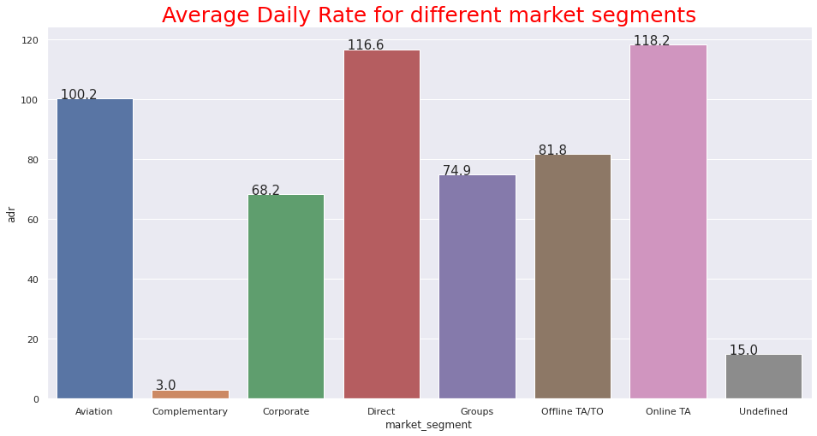
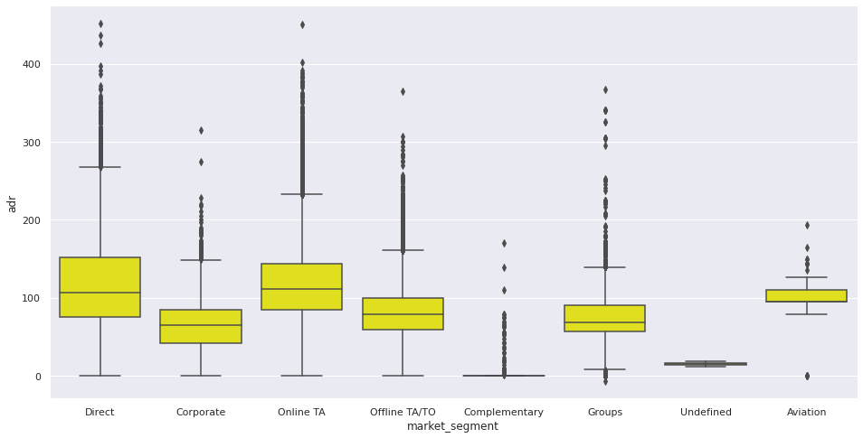
Daily rate for different Market segment

Slide 13
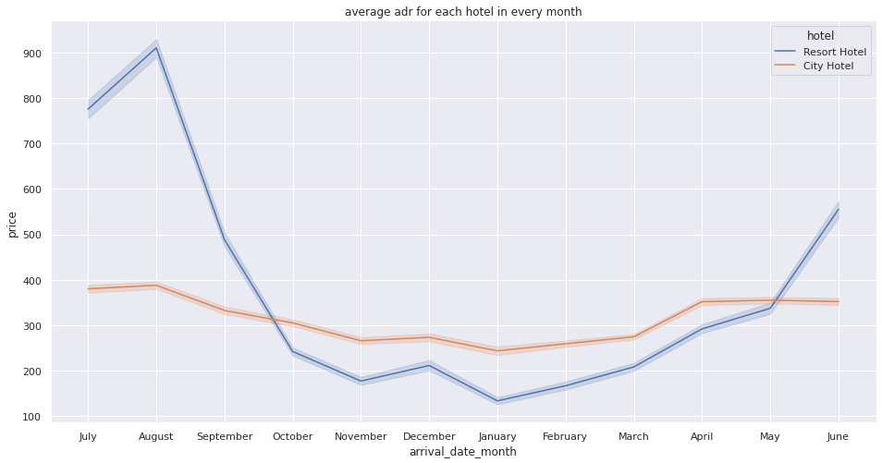
Daily rate for different Months of the year
Ans to first qes.
In between November to Jan ADR is very low for both Hotel.
Form Nov to Jan there will be holidays in European countries
Due to Holidays hotel may provide hoigher discount to attract more guests.

Slide 14
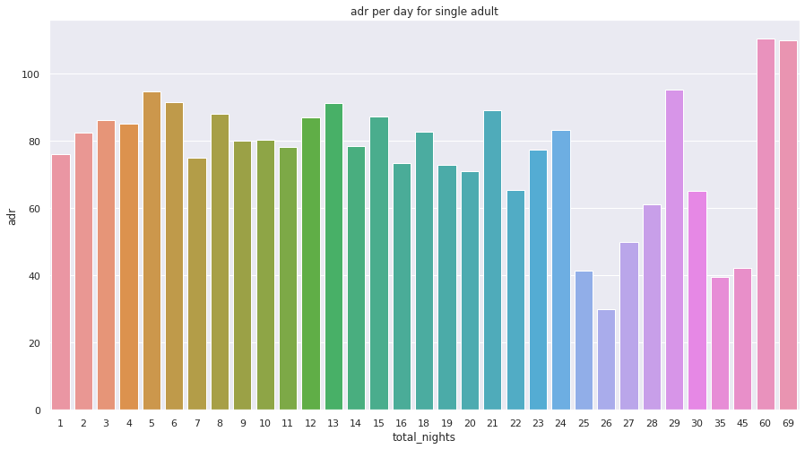
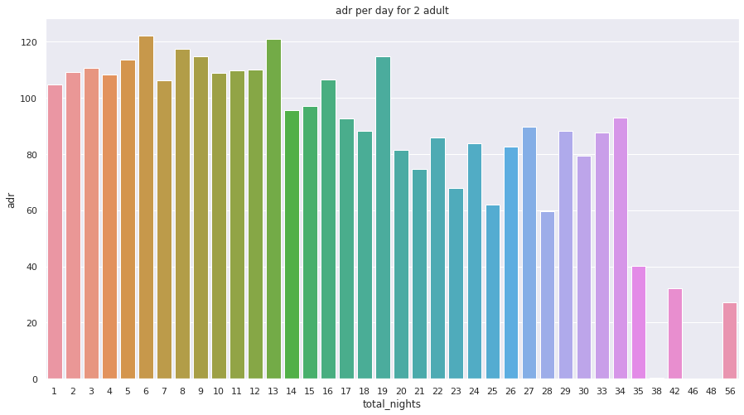
Daily rate As per number of Adults staying

Slide 15
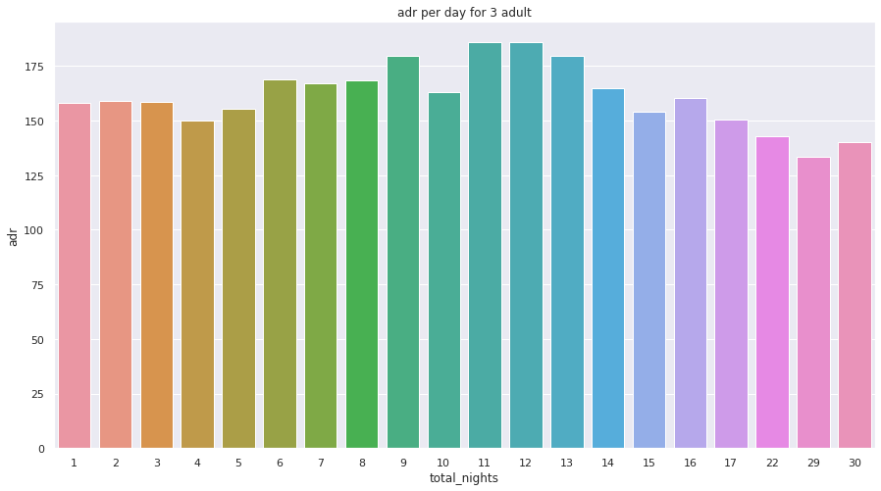
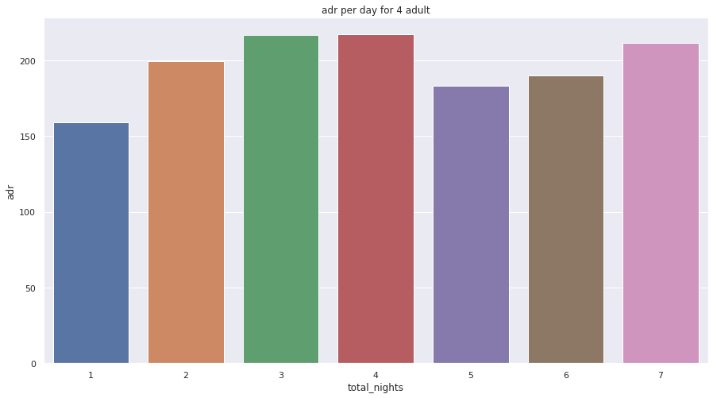
Daily rate As per number of Adults staying

Slide 16
Maximum Optimal length of staying to get best ADR
Optimal length of stay in order to get the best daily rate depends on number of adults booking and number of Nights.
If we know how many number of adults are booking we can predict best adr.
For example if we have 4 adults then optimal length to stay would be 1 night or 5 nights

Slide 17
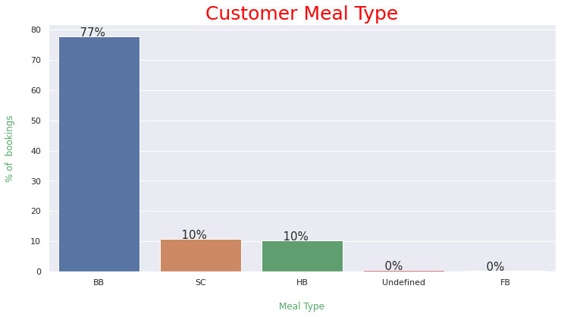
Meals
Type of meal booked. Undefined/SC – no meal package
BB – Bed & Breakfast
HB – Half board (breakfast and one other meal – usually dinner)
FB – Full board (breakfast, lunch and dinner)
The Bread & Breakfast option is the most popular, with a frequency of 77.84%.

Slide 18
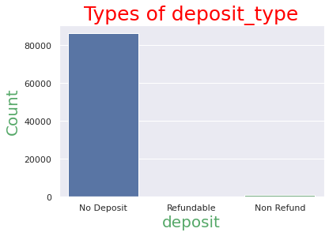
Deposits
There are elements available under deposit column:-
No deposit,
Refundable,
Not refundable
Here in graph we can see that bar reflecting no deposit is quit high.
We can conclude that majority of the booking does not require deposit. This could be a reason why the cancelation rate is high.

Slide 19
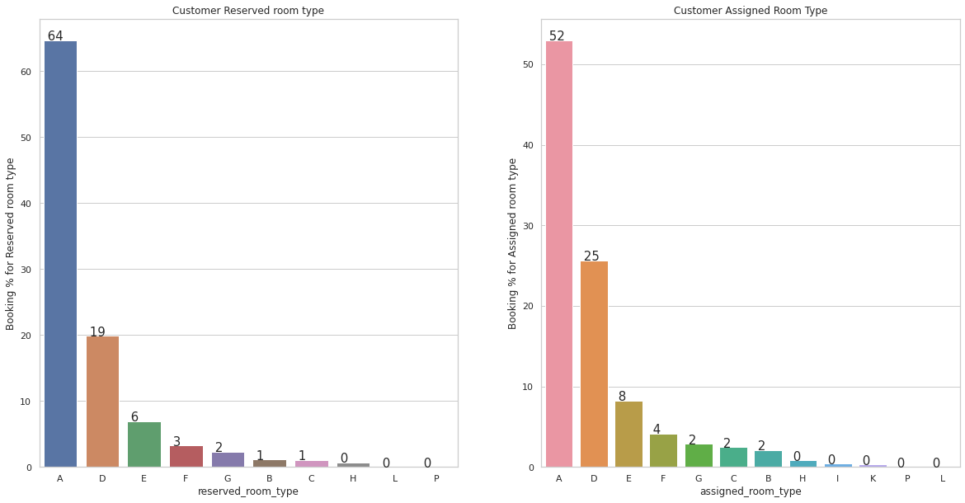
Reserved room type & Assigned room type bookings
The Types of Reserved rooms are A, B, C, D, E, F, G, H, L.
Room Type A & D seems very popular among the customers.
The maximum bookings of around 66% are reserved for the room type A, followed by at 19% reserved for the room type D.
The Types of Assigned rooms are A, B, C, D, E, F, G, H, I, K. Maximum bookings are assigned for the room type A i.e around 51% out of 66% of the reserved room type for A.

Slide 20
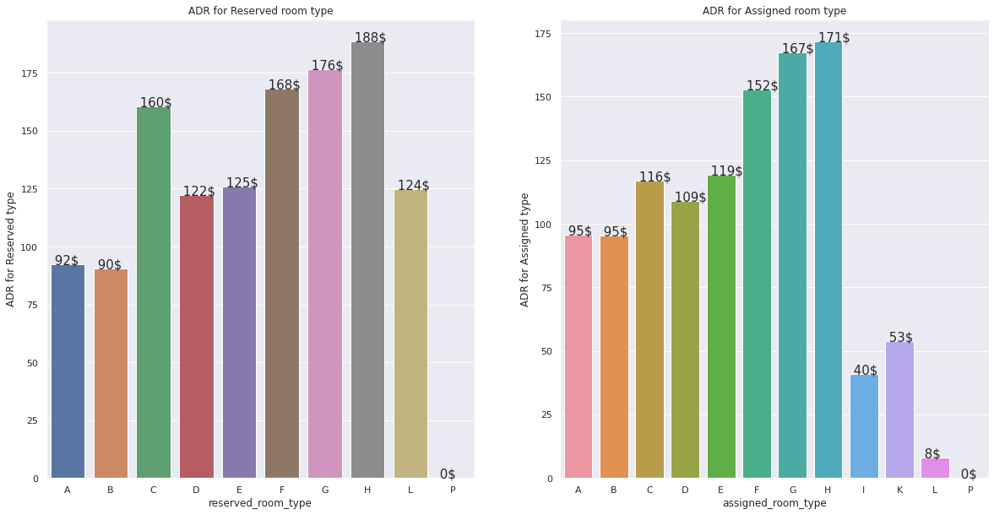
Reserved room type & Assigned room type bookings
ADR is highest for Reserved room type H followed by Reserved room type G
ADR for room type A & B are the lowest.
As Couple (or 2 adults) is the most popular accommodation type with about 65%, so my guess is Room type A & D can be Single room & Double room because these are most booked room types in hotel industry.
Some room types determined by bed availability as Queen-sized bed, King-sized bed, a room with two twin-sized beds.
Also the adr corresponding to the room type A & D are among the lowest.

Slide 21
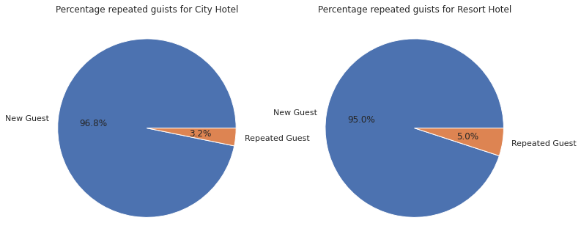
Overview of repeated guests The percentage of repeated guests for Resort Hotel is higher than City Hotel

Slide 22
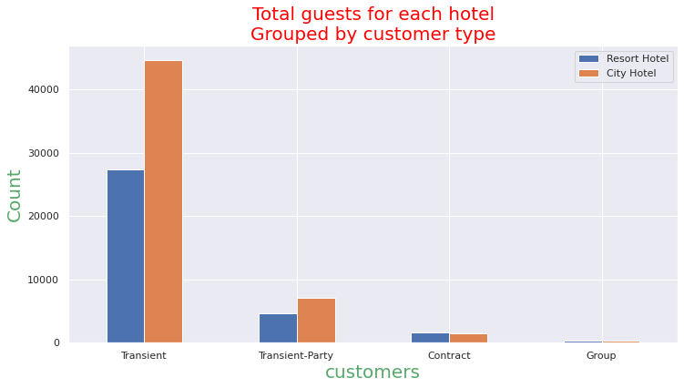
Looking at types of guests
Type of booking, assuming one of four categories:
Contract — when the booking has an allotment or other type of contract associated to it;
Group — when the booking is associated to a group;
Transient — when the booking is not part of a group or contract, and is not associated to other transient booking;
Transient-party — when the booking is transient, but is associated to at least other transient booking
Majority of the bookings are transient. This means that the booking is not part of a group or contract. With the ease of booking directly from the website, most people tend to skip the middleman to ensure quick response from their booking.Trasients are the most common customer type, they represent 79.40% of the total customers.

Slide 23
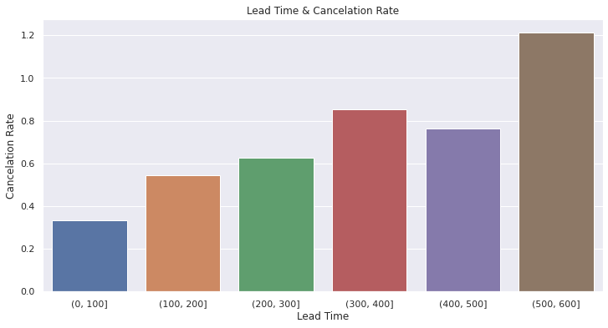
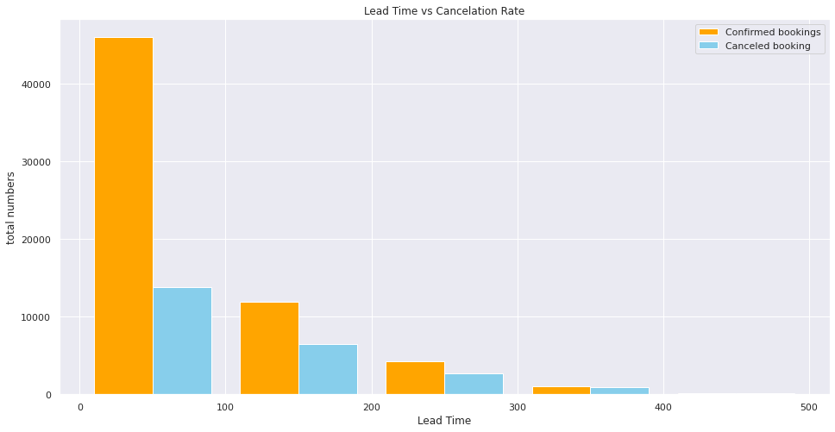
Relation between Lead Time & Cancelation Rate It is clear that the percentage of cancellation increases as lead time increases. We can clearly make the inference that Cancellation rate is directly proportional to the Lead time i.e as the Lead time increases the cancellation rate also increases.

Slide 24
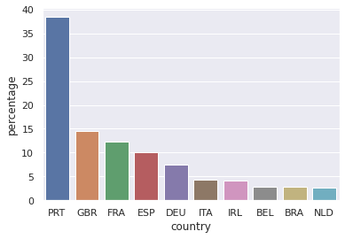
Visitors origin
This graph is re[resentencing visitors origin
Here we can see the count of visitors coming from
So they don't entertain hotels which put them on waiting list for too long.
In general hotel mangement sees that they make arrngement immediatelty and provide rooms to them with almost zero waiting list.

Slide 25

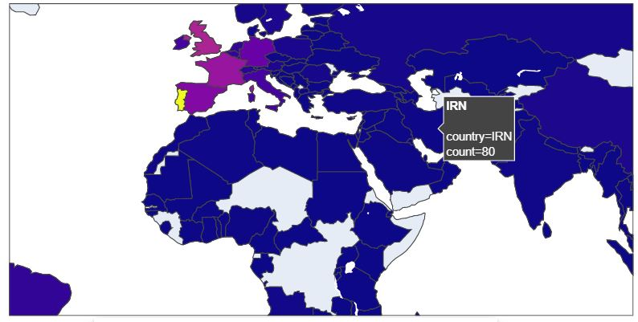
Visitors origin

Slide 26
Inferences and Conclusion
The majority of guests come from western europe countries.
Majority of the hotels booked are city hotel.
The number of repeated guests is too low.
City hotel has highest percentage of cancellation rate.
We also realize that the high rate of cancellations can be due high no deposit policies.
The month of January and February has less waiting time compared to other months.
Both the hotels has high percentage of special request but the City hotel likely to receive a high number of special requests as its percentage of special requests is 71.
The optimal length of stay in order to get the best daily rate varies as the number of adults varies
we do not have repeated guests, we should target our advertisement on guests to increase returning guests.

